Slide 1
Implementasi Struktur Data bst/ avl
Program Studi Diploma III Teknik Informatika
Fakultas Ilmu Terapan
Universitas Telkom

Slide 2
Binary Search Tree
For every node X in the tree, the values of all the keys in the left subtree are smaller than the key in X and the values of all the keys in the right subtree are larger than the key in X
The binary-search-tree property allows us to print out all the keys in a binary search tree in sorted order by inorder tree walk.

Slide 3
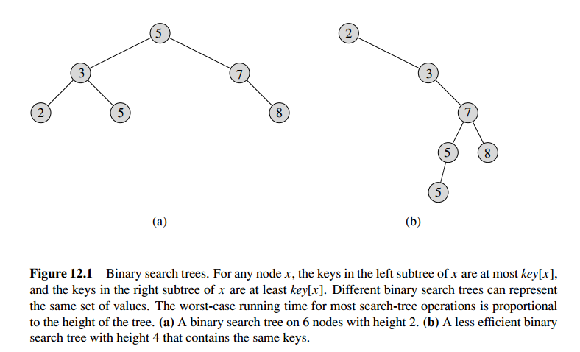

Slide 4
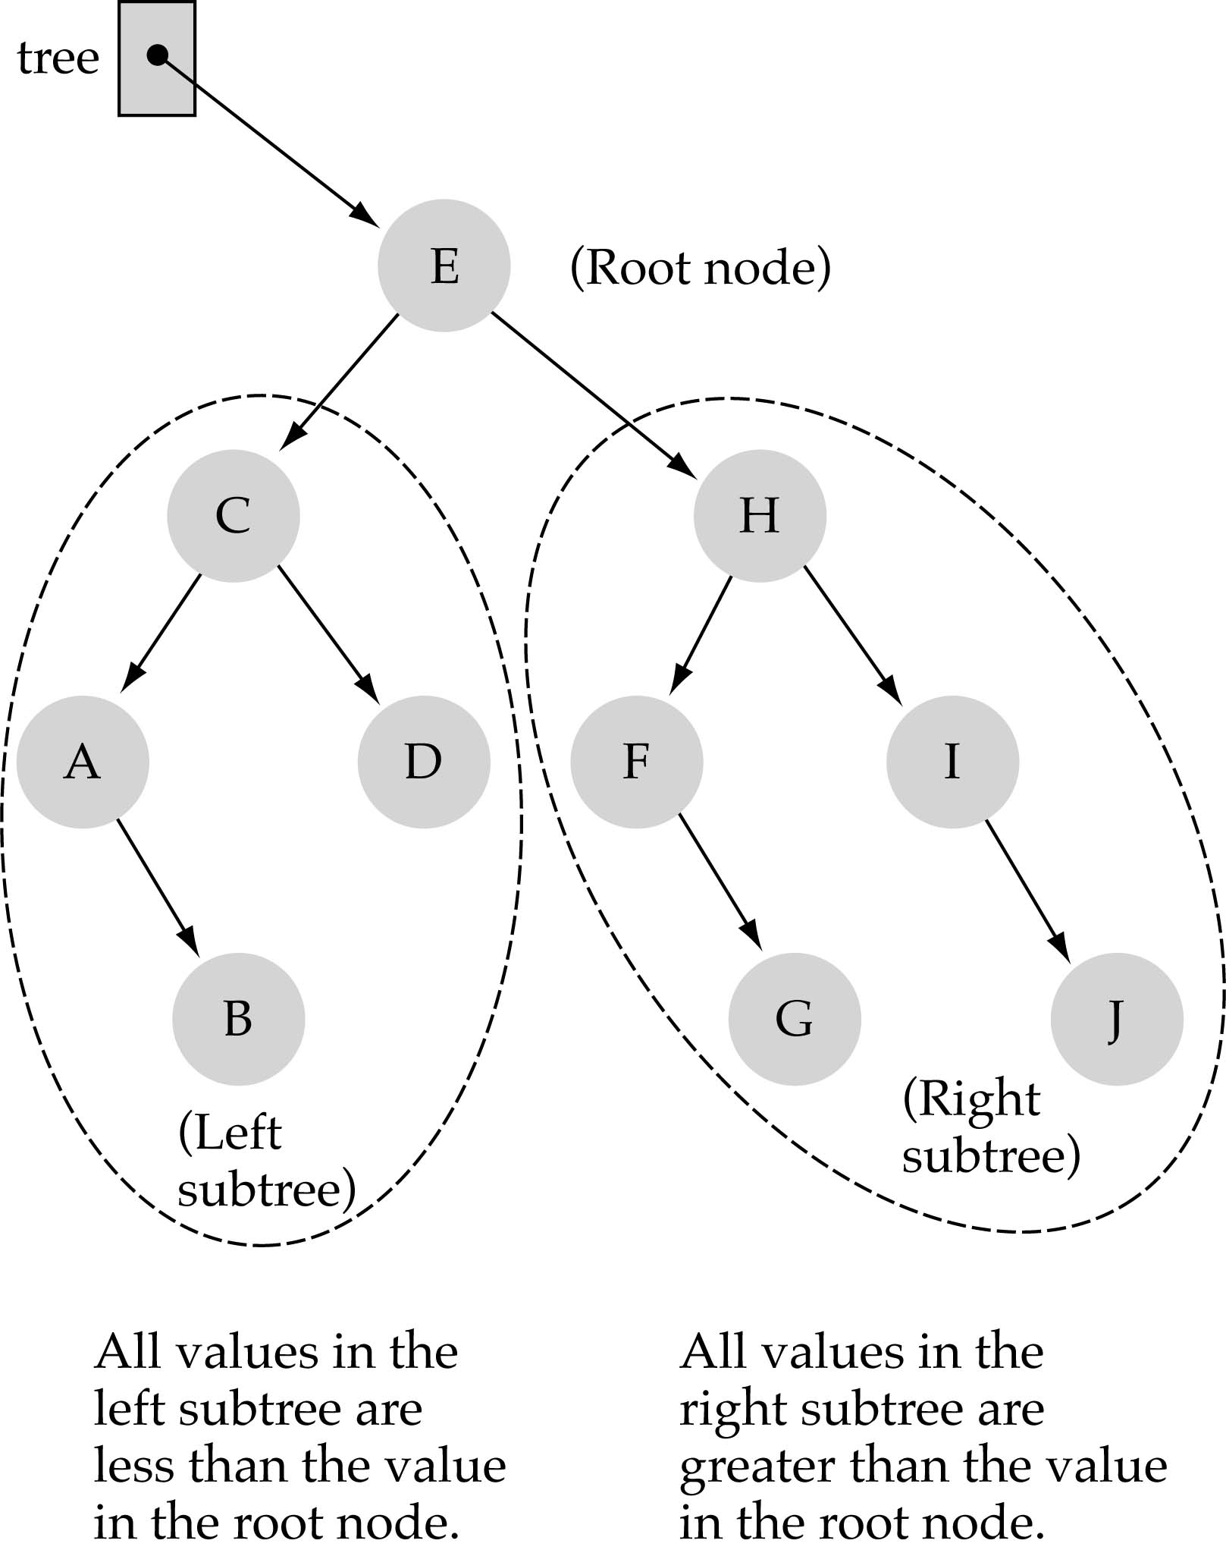
Binary Search Trees (BSTs)
In a BST, the value stored at the root of a subtree is greater than any value in its left subtree and less than any value in its right subtree

Slide 5
Binary Search Trees (BSTs)
Dimanakah letak elemen terkecil?
Elemen paling kiri
Dimanakah letak elemen terbesar?
Elemen paling kanan

Slide 6
OPERASI pada BST
Searching
Insert
Delete
Find Minimum
Find Maximum
Look up Successor
Look up Predecessor

Slide 7
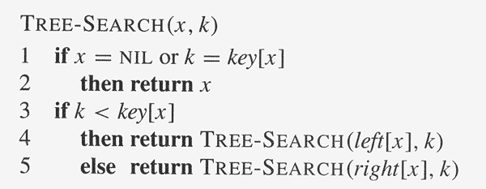
Algoritma Searching

Slide 8
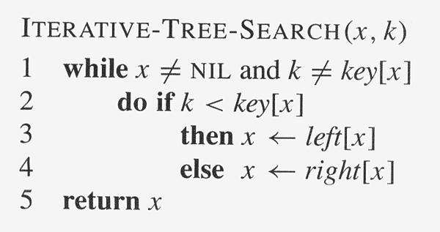
Algoritma Searching

Slide 9
How to search a binary search tree?
(1) Start at the root
(2) Compare the value of the item you are searching for with the value stored at the root
(3) If the values are equal, then item found; otherwise, if it is a leaf node, then not found

Slide 10
How to search a binary search tree?
(4) If it is less than the value stored at the root, then search the left subtree
(5) If it is greater than the value stored at the root, then search the right subtree
(6) Repeat steps 2-6 for the root of the subtree chosen in the previous step 4 or 5

Slide 11
Find Minimum / Maximum
An element in a binary search tree whose key is a minimum can always be found by following left child pointers from the root until a NULL is encountered
The pseudocode for TREE-MAXIMUM is symmetric.
Kapan dipakai?
Menentukan Predecessor / Successor

Slide 12
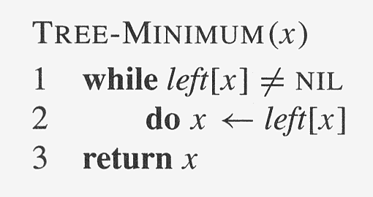
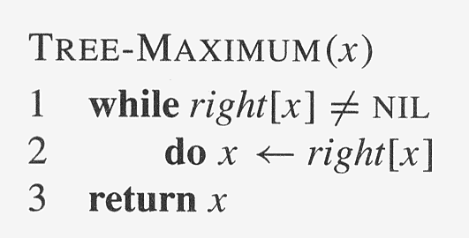

Slide 13
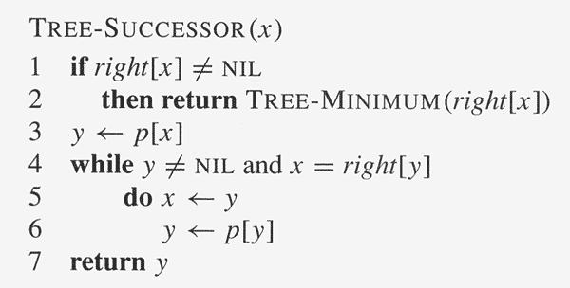

Slide 14
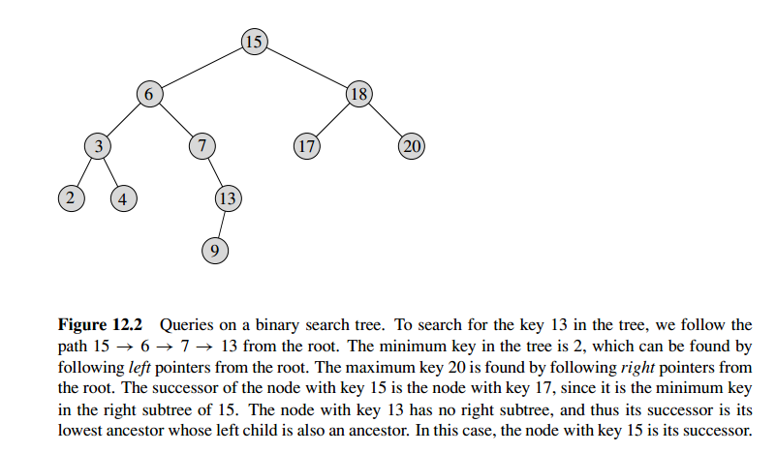

Slide 15
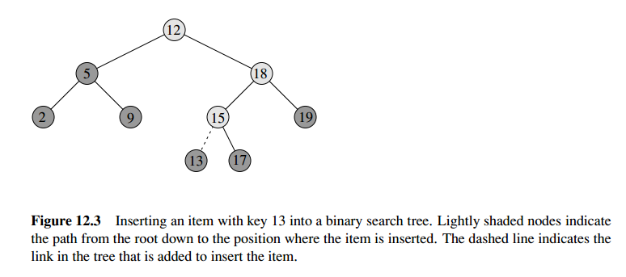
insertion

Slide 16
Insertion
Penyisipan sebuah elemen baru dalam binary search tree, elemen tersebut pasti akan menjadi leaf
Insert X into a binary search tree:
Start from the root.
If the value of X is less than the value of the root, then X should be inserted on the left sub-tree.
On the other hand, if the value of X is greater than the value of the root, then X should be inserted on the right sub-tree.
Remember that, a sub tree is also a tree. So, the problem to insert an element in the sub-tree is same as the problem to insert an element in the root.
Recursive approach.

Slide 17
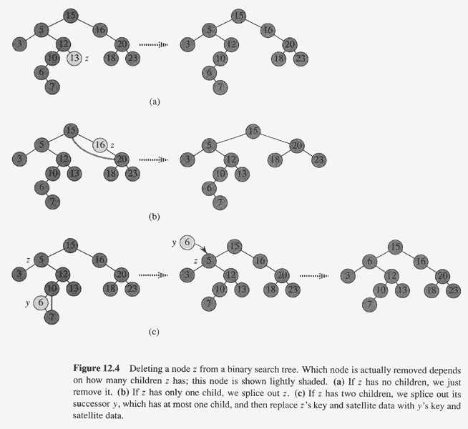
deletion

Slide 18
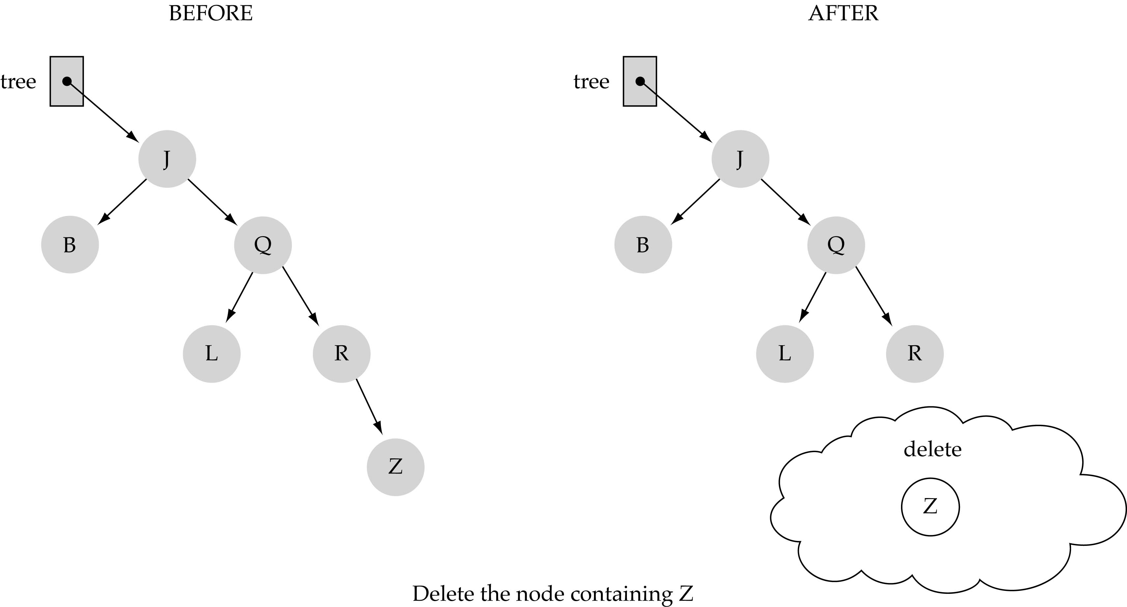
(1) Deleting a leaf

Slide 19
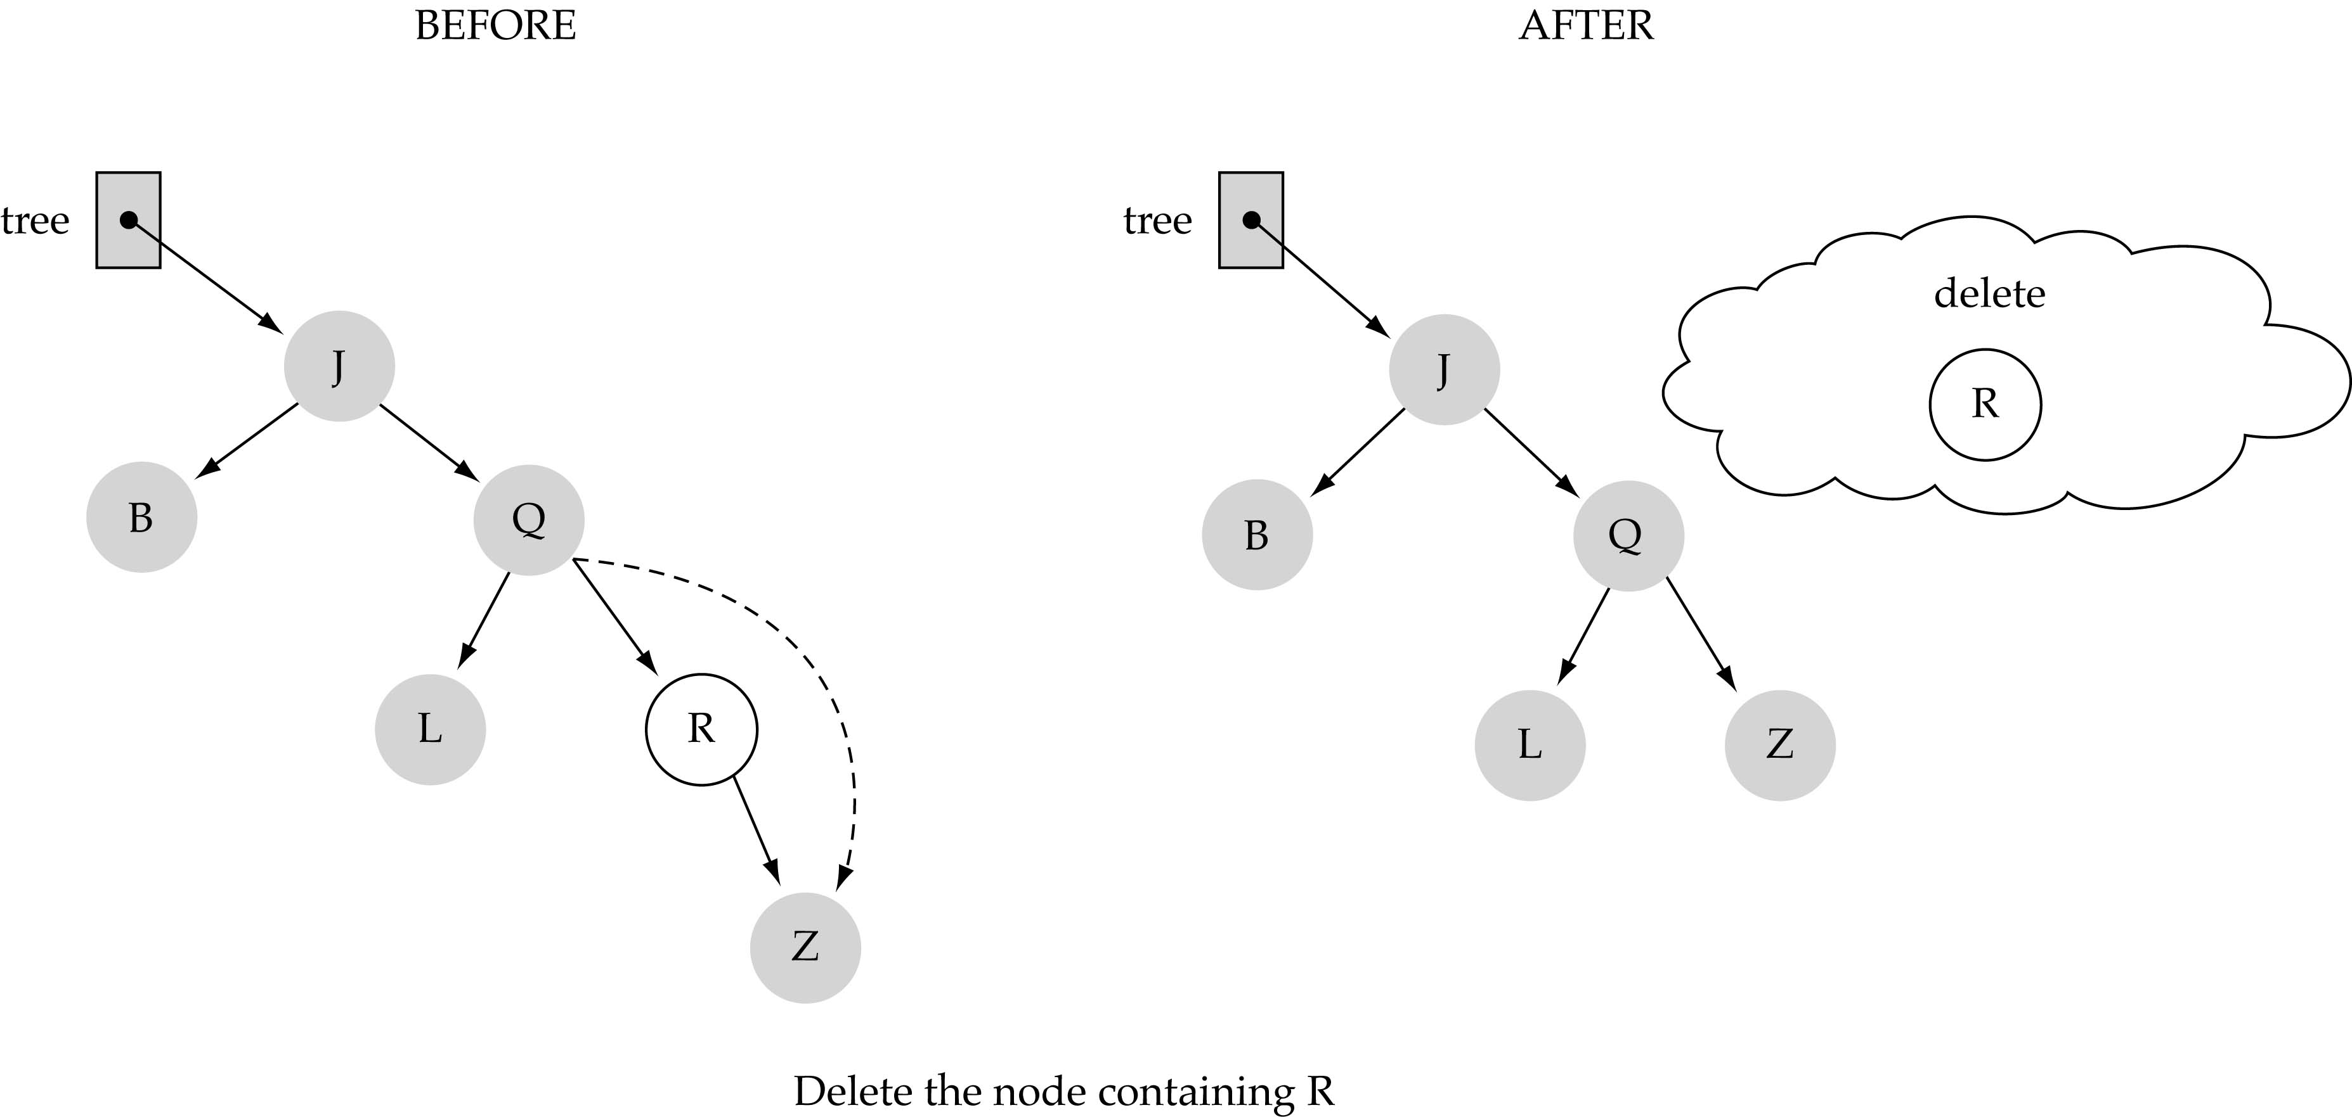
(2) Deleting a node with only one child

Slide 20
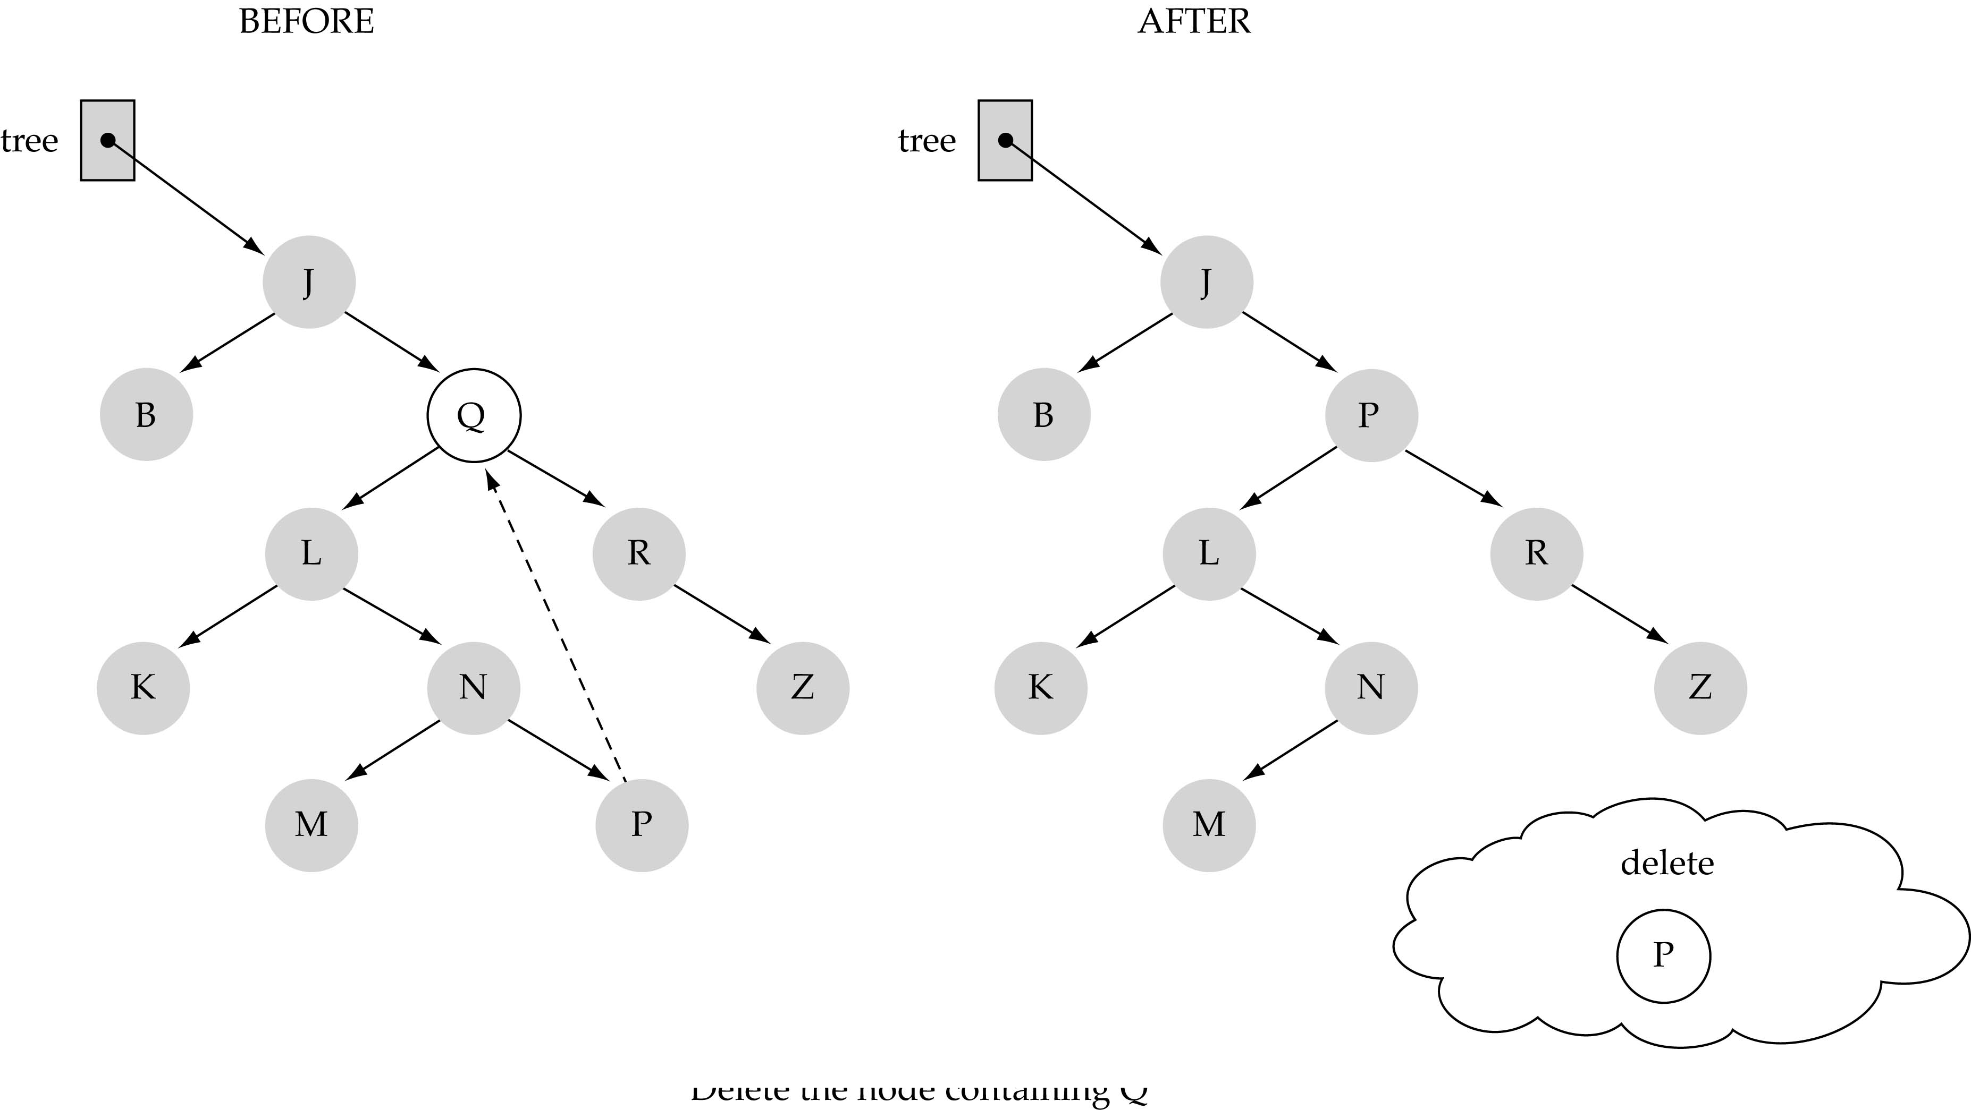
(3) Deleting a node with two children

Slide 21
(3) Deleting a node with two children (cont.)
Find predecessor (i.e., rightmost node in the left subtree)
Replace the data of the node to be deleted with predecessor's data
Delete predecessor node

Slide 22
A v l

Slide 23
AVL Tree
The AVL tree is named after its two Soviet inventors, G. Adelson-Velsky and E. M. Landis, who published it in their 1962 paper "An algorithm for the organization of information".
AVL tree is a self-balancing binary search tree.
BST → For every node X in the tree, the values of all the keys in the left subtree are smaller than the key in X and the values of all the keys in the right subtree are larger than the key in X
Notes:
Balance factor -> height dari anak sebelah kanan – height dari anak sebelah kiri

Slide 24
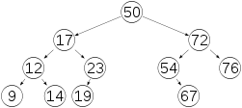
AVL Tree
In an AVL tree, the heights of the two child subtrees of any node differ by at most one.

Slide 25
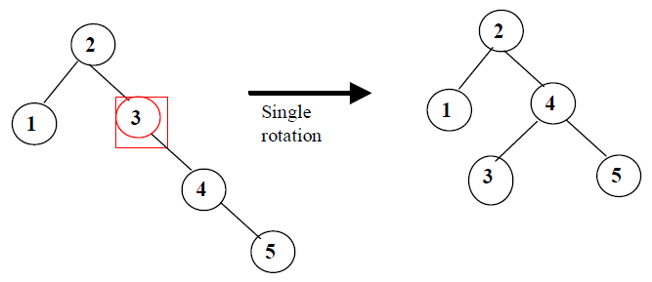
AVL Tree
If at any time they differ by more than one, rebalancing is done to restore this property.
Notes:
Balance factor -> height dari anak sebelah kanan – height dari anak sebelah kiri

Slide 26
Balance factor
Pada AVL, pohon BST yang dibentuk harus seimbang (baik seimbang secara penuh, seperti CBT, atau seimbang sebagian)
Balance factor dapat menjamin keseimbangan tersebut, dengan rumus:
Balance factor = tinggi(subtree kiri) – tinggi(subtree kanan)
Pada literatur lain, pengurangan dilakukan sebaliknya (subtree kanan dikurangi subtree kiri)
Balance factor harus dihitung untuk setiap node pada AVL.
Untuk setiap node, tinggi subtree kiri hanya boleh berbeda paling besar satu dengan subtree kanannya

Slide 27
Balance factor (con’t)
Jika suatu node menyebabkan AVL tidak seimbang, dilakukan rotasi pada bagian yang tidak seimbang tersebut
AVL adalah self-balance tree, jadi pengecekan keseimbangan pohon dilakukan pada saat suatu node dimasukkan ke dalam pohon
Pohon yang hanya memiliki satu node memiliki tinggi 0 (jadi, node yang tidak memiliki anak memiliki tinggi 0)
Node kosong memiliki tinggi -1

Slide 28
Balance factor - example

Slide 29
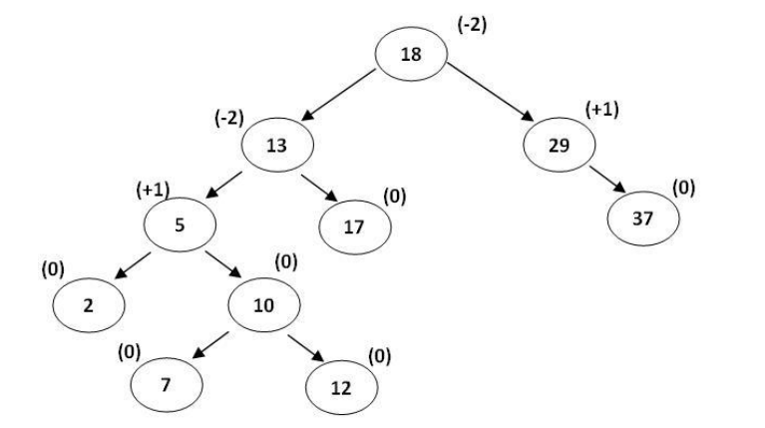
Balance factor - example
Notes:
the height of the tree is 4, meaning the lenght of the longest path from the root to a leaf node.
the height of the left subtree of the root is 3, meaning that the lenght of the lognest path
from the node 13 to one of the leaf nodes (2, 7 or 12).
for finding the balancing factor of the root we substract the height of the right subtree and
the left subtree : 1-3 = - 2. -the balancing factor of the node with the key 12 is very easy to determine
- We notice that the node has no children so the balancing factor is 0.
for finding the balancing factor of the node with key 5
we substract the height of the right subtree from the height of the left subtree: 1 - 0 = +1.

Slide 30
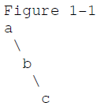

Rebalancing 1: Left Rotation
To fix right heavy AVL tree, we must perform a left rotation, rooted at A.
b becomes the new root.
a takes ownership of b's left child as its right child, or in this case, null.
b takes ownership of a as its left child.

Slide 31
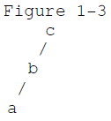

Rebalancing 2: Right Rotation
To fix left heavy AVL tree, we must perform a right rotation, rooted at C.
b becomes the new root.
c takes ownership of b's right child, as its left child. In this case, that value is null.
b takes ownership of c, as it's right child.

Slide 32

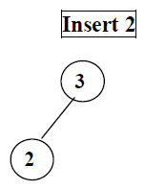
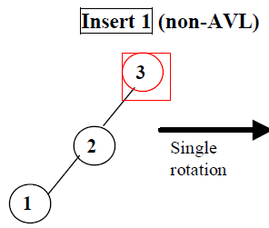
Example
Which rotation? Left or Right?

Slide 33
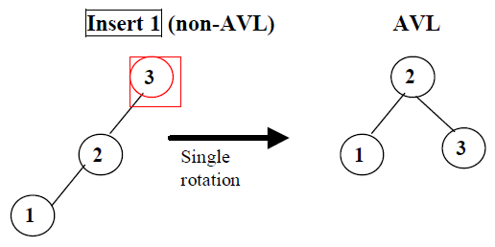

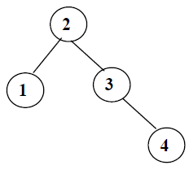
Example
Di mana node 4 diletakkan?

Slide 34

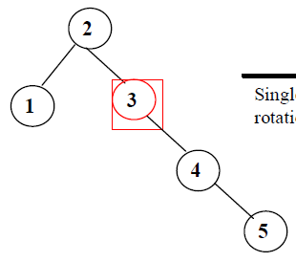
Example
Di mana node 5 diletakkan?
Which rotation? Left or Right?

Slide 35
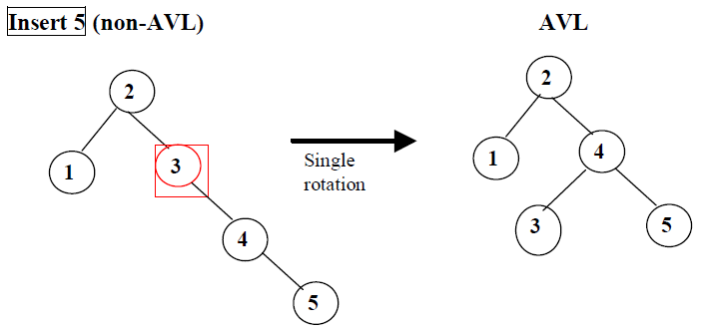
Example

Slide 36
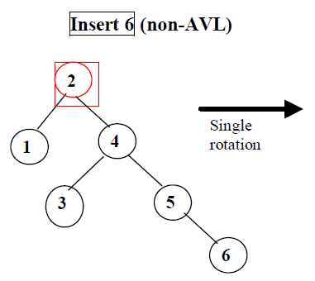
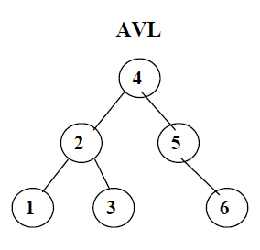
Example
Which rotation? Left or Right?

Slide 37
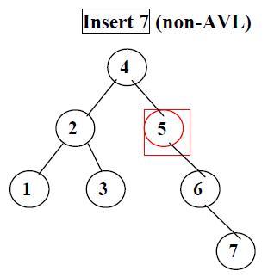
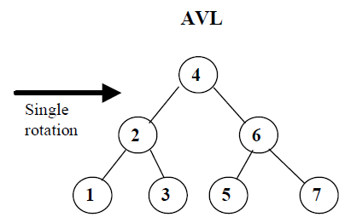
Example
Which rotation? Left or Right?

Slide 38
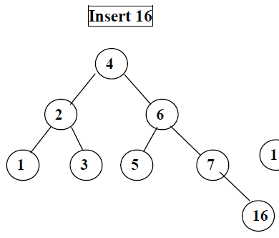
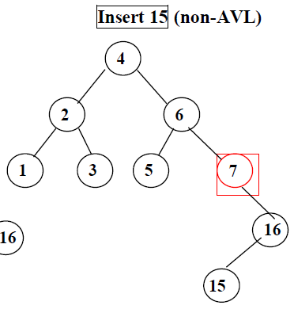
Example
Which rotation? Left or Right?

Slide 39
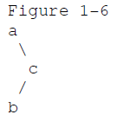
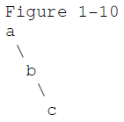
Rebalancing 3: Left-Right Rotation
Perform a right rotation on the right subtree.
We are not rotating on our current root.
We are rotating on our right child.

Slide 40

Rebalancing 3: Left-Right Rotation
Perform a right rotation on the right subtree.
Perform a left rotation.

Slide 41
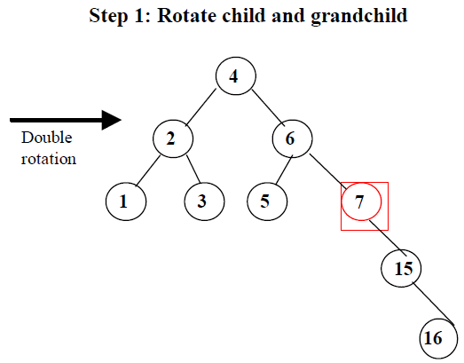
Example

Slide 42
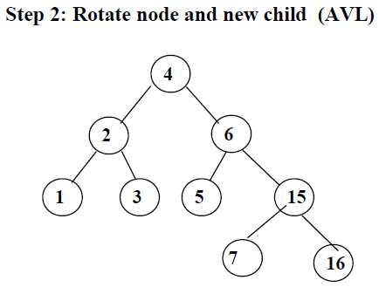
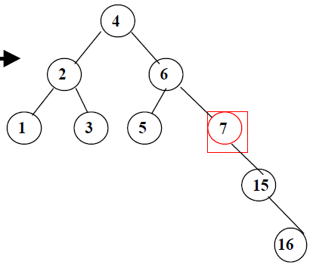

Example
Di mana node 14 diletakkan?

Slide 43
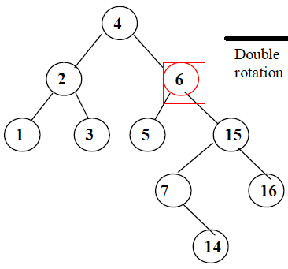
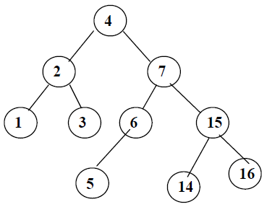
Example

Slide 44
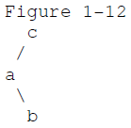
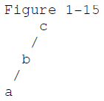
Rebalancing 4: Right-Left Rotation
Perform a left rotation on the left subtree.
We are not rotating on our current root.
We are rotating on our left child.

Slide 45

Rebalancing 4: Right-Left Rotation
Perform a left rotation on the left subtree.
Perform a right rotation.

Slide 46
References
Hargrove, J. “The AVL Tree Rotations Tutorial”. 2007.
Riera, J. “AVL Trees Example”. 2001.
Adelson-Velsky, G.; Landis, E. M. (1962). "An algorithm for the organization of information". Proceedings of the USSR Academy of Sciences (in Russian) 146: 263–266. English translation by Myron J. Ricci in Soviet Math. Doklady, 3:1259–1263, 1962.
Sedgewick, R. “Algorithms”. Addison-Wesley, 1983, ISBN 0-201-06672-6, page 199, chapter 15: Balanced Trees.
Denny, “Struktur Data & Algoritme - Binary Search Tree”, Fakultas Ilmu Komputer Universitas Indonesia 2001
Cormen, T.H et all, “Introduction to Algorithms”, 2nd edition, Mc-Graw Hill Book, 2001
CS 302 – Data Structures , Chapter 8, “Binary Search Trees “
AVL Tree – Height Balanced Tree

